Slide 1

ROCKBUSTER STEALTH
FILMS SALES STRATEGY FOR 2020
BY SHIKHA PATHAK

Slide 2
OBJECTIVE
Rock buster Stealth LLC is a movie rental company that used to have stores around the world. Facing stiff competition from streaming services such as Netflix and Amazon Prime, the Rock buster Stealth management team is planning to use its existing movie licenses to launch an online video rental service in order to stay competitive.

Slide 3
QUESTION TO BE ANSWERED
Which movies contributed the most/least to revenue gain?
What was the average rental duration for all videos?
Which countries are Rock buster customers based in?
Where are customers with a high lifetime value based?
Do sales figures vary between geographic regions?

Slide 4
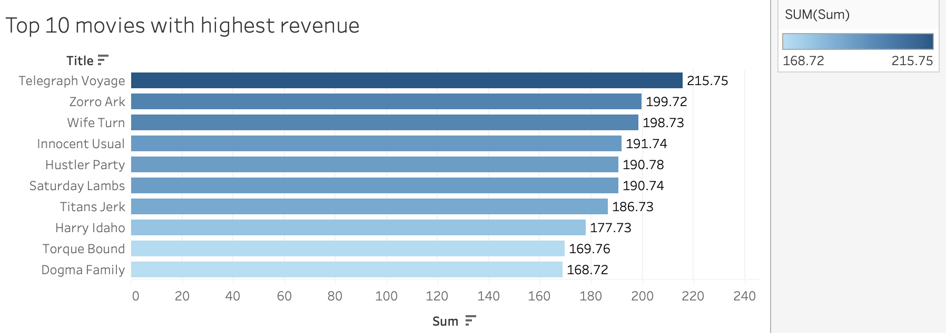
Top 10 movies with Highest Revenue
Top 5 Movies with Highest revenue are:
Telegraph Voyage | 215.75
Zorro Ark | 199.72
Wife Turn | 198.73
Innocent Usual | 191.74
Hustler Party | 190.78

Slide 5
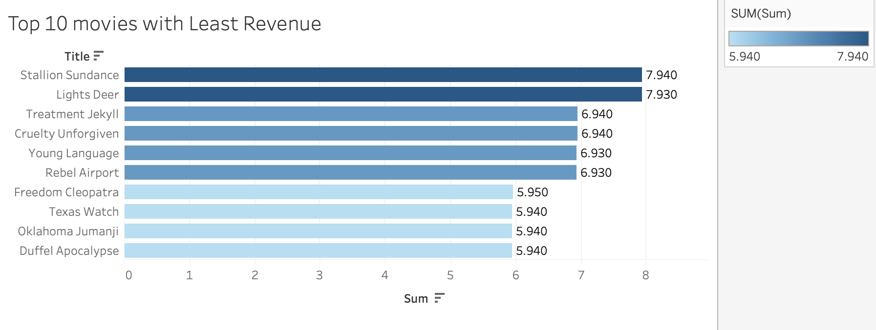
Top 10 movies with LEAST Revenue
Top 5 movies with Least Revenue are :
Texas Watch | 5.94
Oklahoma Jumanji | 5.94
Duffel Apocalypse | 5.94
Freedom Cleopatra | 5.95
Young Language | 6.93

Slide 6
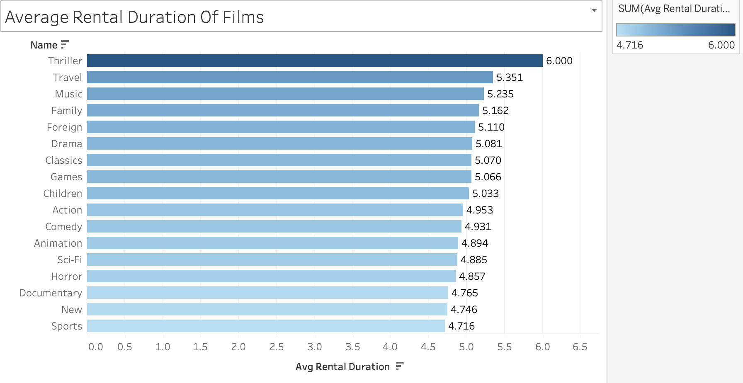
Average Rental Duration Of Films
Average Rental Period varies
based on Film genre.
• Genre with the highest
average is 6 days is Thriller and,
• Genre with the lowest
rental average is Sports.
Average duration for all films
is 4.985

Slide 7
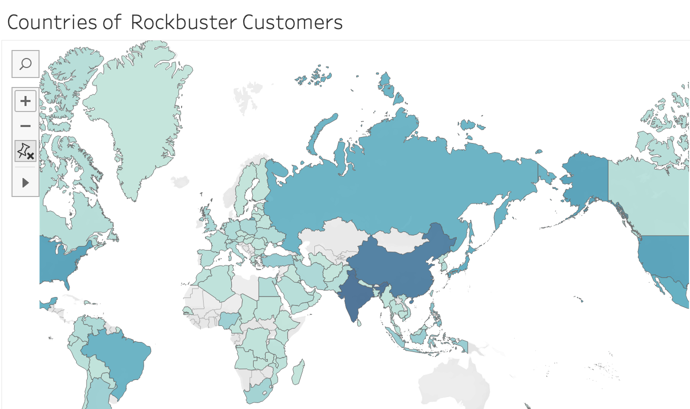
Countries of rock buster customers
Top 3 countries with most
customers base –
India
China
United States

Slide 8
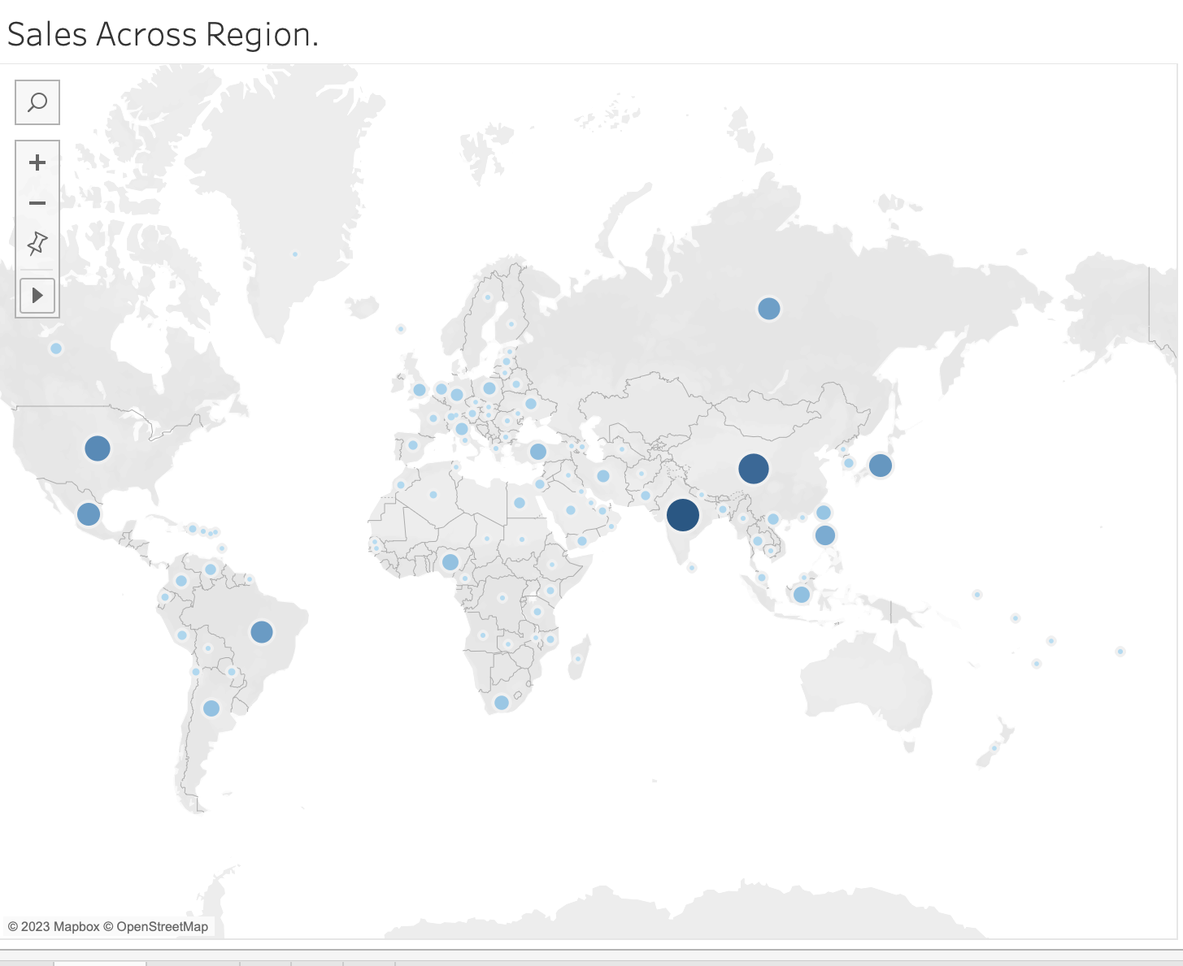
Sales Across region
Sales Of Top 10 Countries:
India | 6034.78
China | 5251.03
United States | 3685.31
Japan | 3122.51
Mexico | 2984.82
Brazil | 2919.19
Russian Federation | 2765.62
Philippines | 2219.7
Turkey | 1498.49
Indonesia | 1352.69

Slide 9
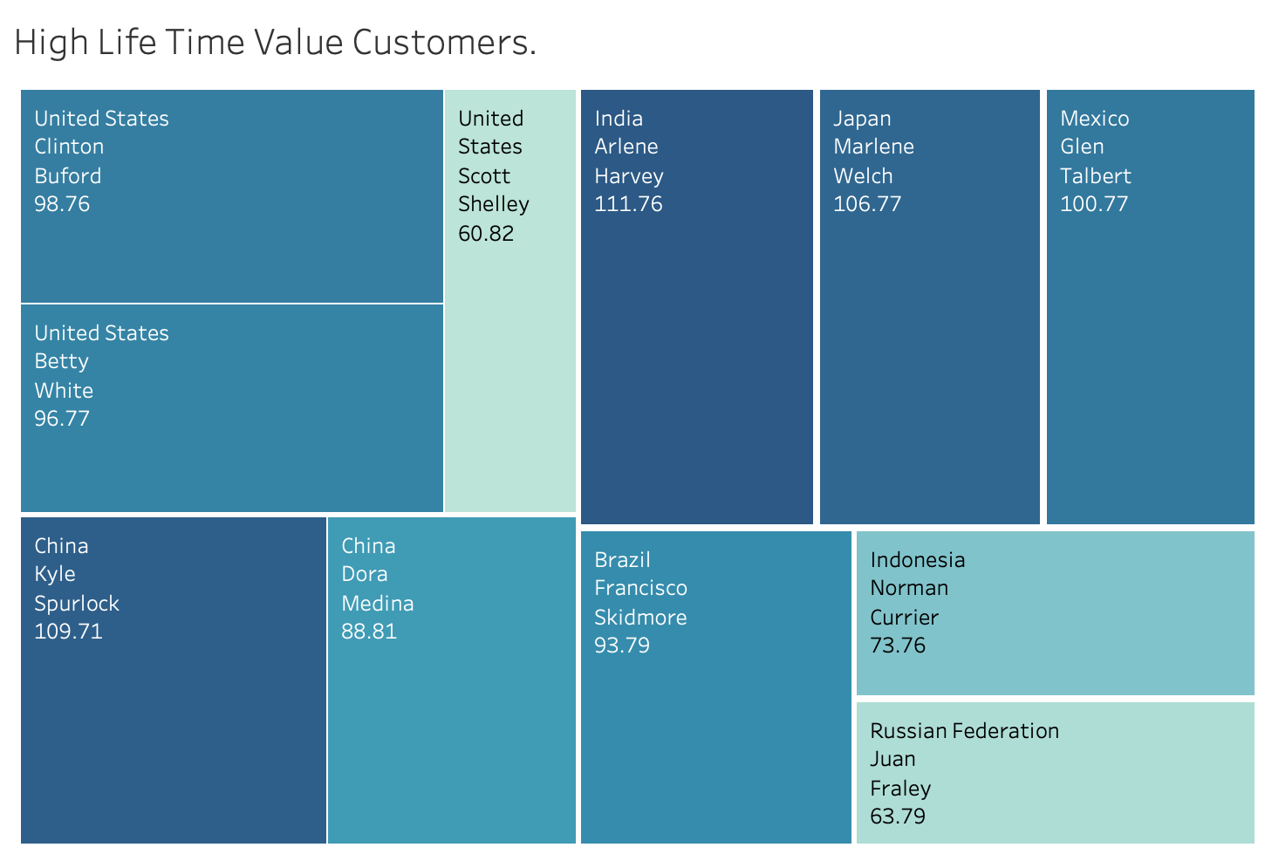
HIGH LIFE TIME VALUE CUSTOMERS
Arlene Harvey is the highest value customer. 50% of top 10 customers are located in the countries with the highest customer India, China , Japan, Maxico and Brazil.

Slide 10
FINDINGS
Telegraph Voyage, Zorro Ark, Wife Turn, Innocent Usual, and Hustler Party, Saturday Lambs, Titans Jerk, Harry Idaho, Torque Bound and Dogma Family contribute to the most revenue gain.
Stallion Sundance, Lights Deer, Cruelty Unforgiven, Treatment Jekyll, Rebel Airport, Freedom Cleopatra, Oklahoma Jumanji , Texas Watch and Duffel Apocaconlypse tribute to the least revenue.
Average rental duration for all genres except Thriller is 5 days, while Thriller has the highest rental duration of 6 days.
India, China, US, Japan, and Mexico are the top 5 countries with highest amount of Sales.
Top 5 customers with a highest lifetime value are based in India ,China, Japan, Mexico, and US.
Asia is the most profitable region.

Slide 11
RECOMMENDATION
• India, China, and Japan are the main countries to focus on.
• Marketing more in Asia Pacific regions will contribute to increase in revenue.
• Awarding the most loyal customers will help retain customers.
• Introducing a loyalty program can help increase the loyal customer base.

